Slide 1
Ninesilica Tutorial Programming and debugging
Roberto Airoldi
Department of Computer systems
Tampere University of Technology

Slide 2
Outline
Ninesilica architecture
Programming model
How to simulate / debug code
Example: matrix- vector multiplication

Slide 3
Ninesilica architecture (1)
Developed on the base of the Silicon Café Template
Networked multi-core CPU (MPU)
Builds on a DSP-enhanced RISC processor called Coffee
Objectives
Performance scalability
Exposing the full parallel processing capability by efficient communication
Power/performance scalability
Clock gating Techniques
Dynamic Voltage and Frequency Scaling (DVFS)
Driver Applications
Software Defined Radio (SDR)

Slide 4
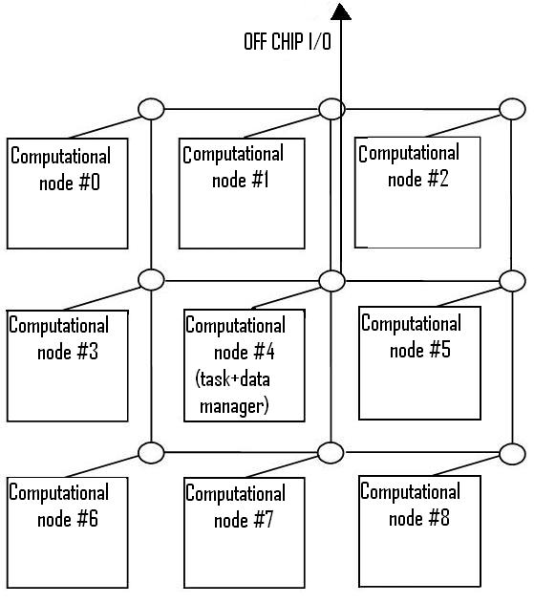
Ninesilica architecture (2)
Ninesilica
9 nodes
8 computational nodes
1 tasks & I/O manager node
Network-on-Chip taps directly in the inter-cluster communication system
Shared memory & ”Message passing communication”
C code programming

Slide 5
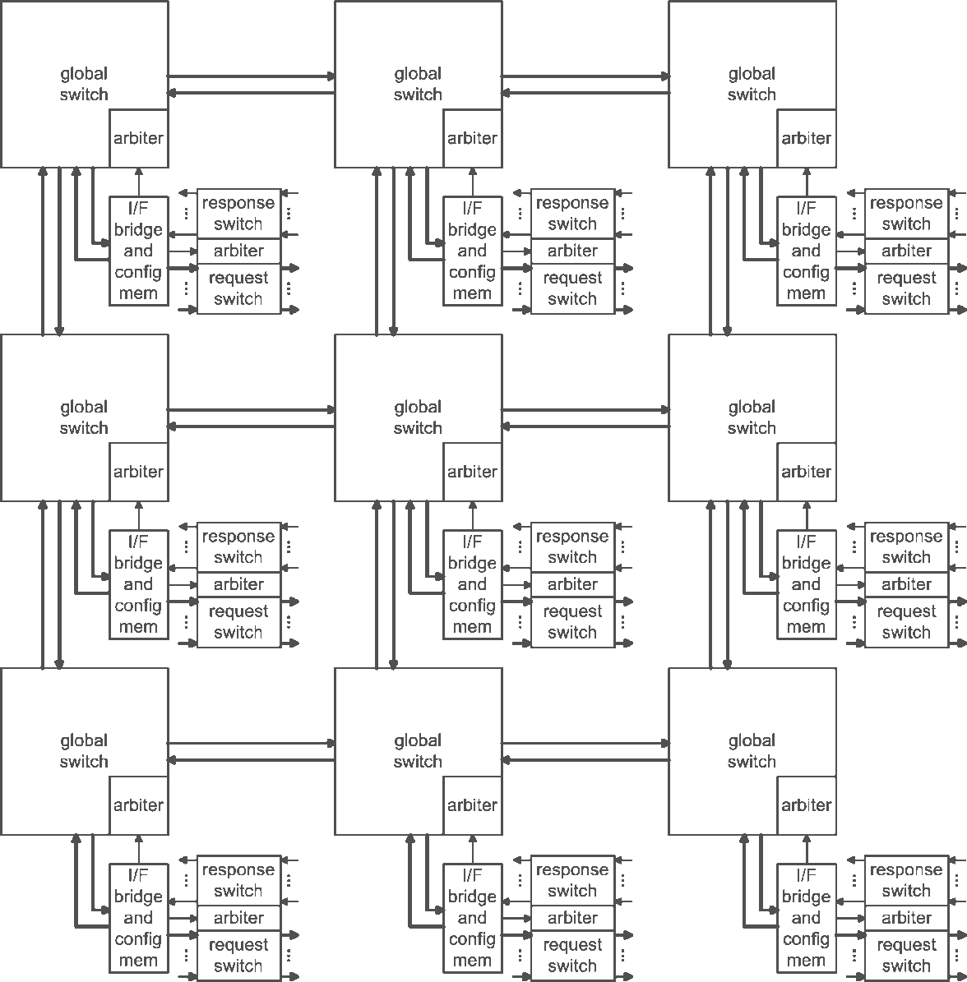
Ninesilica architecture (3)

Slide 6
Ninesilica architecture (4)
1000001
Routing:
HNESW directions
No turn back
3 options as target
Final routing word:
100000110XXX
1000
100000110XXX

Slide 7
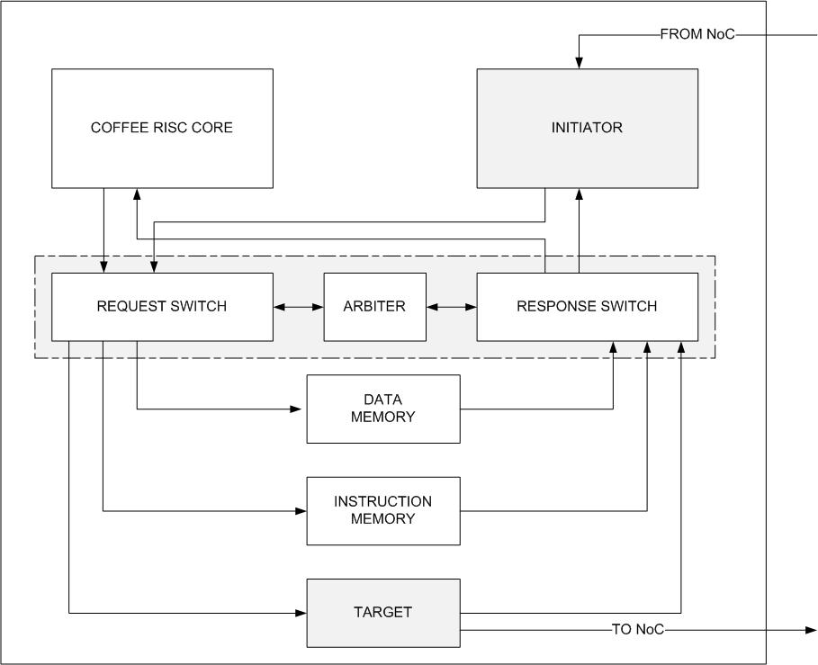
Ninesilica architecture (5)
Address | Routing Path (defined in VHDL)
01000000 | Path 1
02000000 | Path 2
0X000000 | Path X
0F000000 | Path 16
00000 - 1FFFF
200000 - 23FFFF
01000000 - 0FFFFFFF

Slide 8
Programming model (1)
How to address a data out of the node:
Define the path and the associate address: from node 0 to node 1 path 1?
Define the peripheral to hit:
DMEM
IMEM
Target (to repeat the msg)
C code:
Pointer to the address
Write on the pointer

Slide 9
Programming model (2)
How does it look like in C:
#define CPU_1_ADDR 0x01000000
#define DMEM_ADDR 0x00000000
#define IMEM_ADDR 0x00200000
volatile char *p_coef;
Volatile INT *Send_Data;
Int mail ()
...
p_coef = (char *)(CPU_1_ADDR + DMEM_ADDR + (char *) *(flag+16));
Send_Data = (int *) p_coef;
*Send_Data= 10;
...

Slide 10
Programming model (3)
Where to send the data?
Shared space defined at the same address for each node:
extern char shared_space[96];
Gives you a possibility to synchronise data exchange and exchange data addresses
Use it as synch-flag and repository for data-addresses of variables of other nodes.

Slide 11
Programming model (4)
Usually we write two C codes:
Master: target the central node and it controls the data distributtion, synchronization, power saving and executioin steps
Slave: it is common to the 8 nodes surrounding the central node; working on a different data set according to the COREID set.

Slide 12
How to simulate / debug code (1)
Compile your code:
master + slave
Compile the HDL
Use the script XXX/NoC_platform/SCRIPTS/NoC_platform_GBGT.sh
Load the top entity
Vsim net.net_sim &
Execute the simulation
Remember to load the waveform first
Restart –f; run XXXXX [ns]

Slide 13
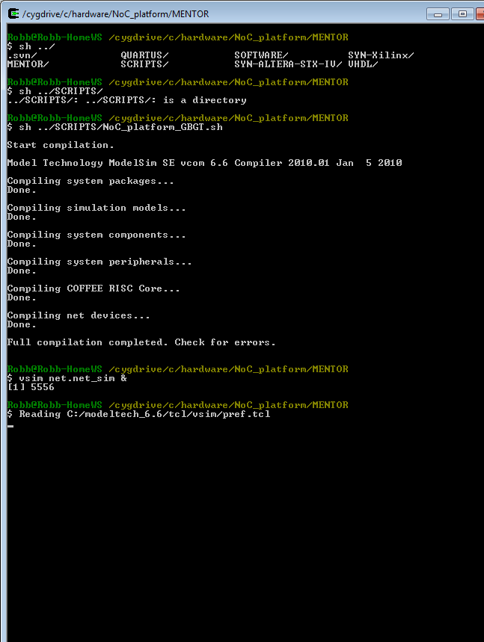

Slide 14
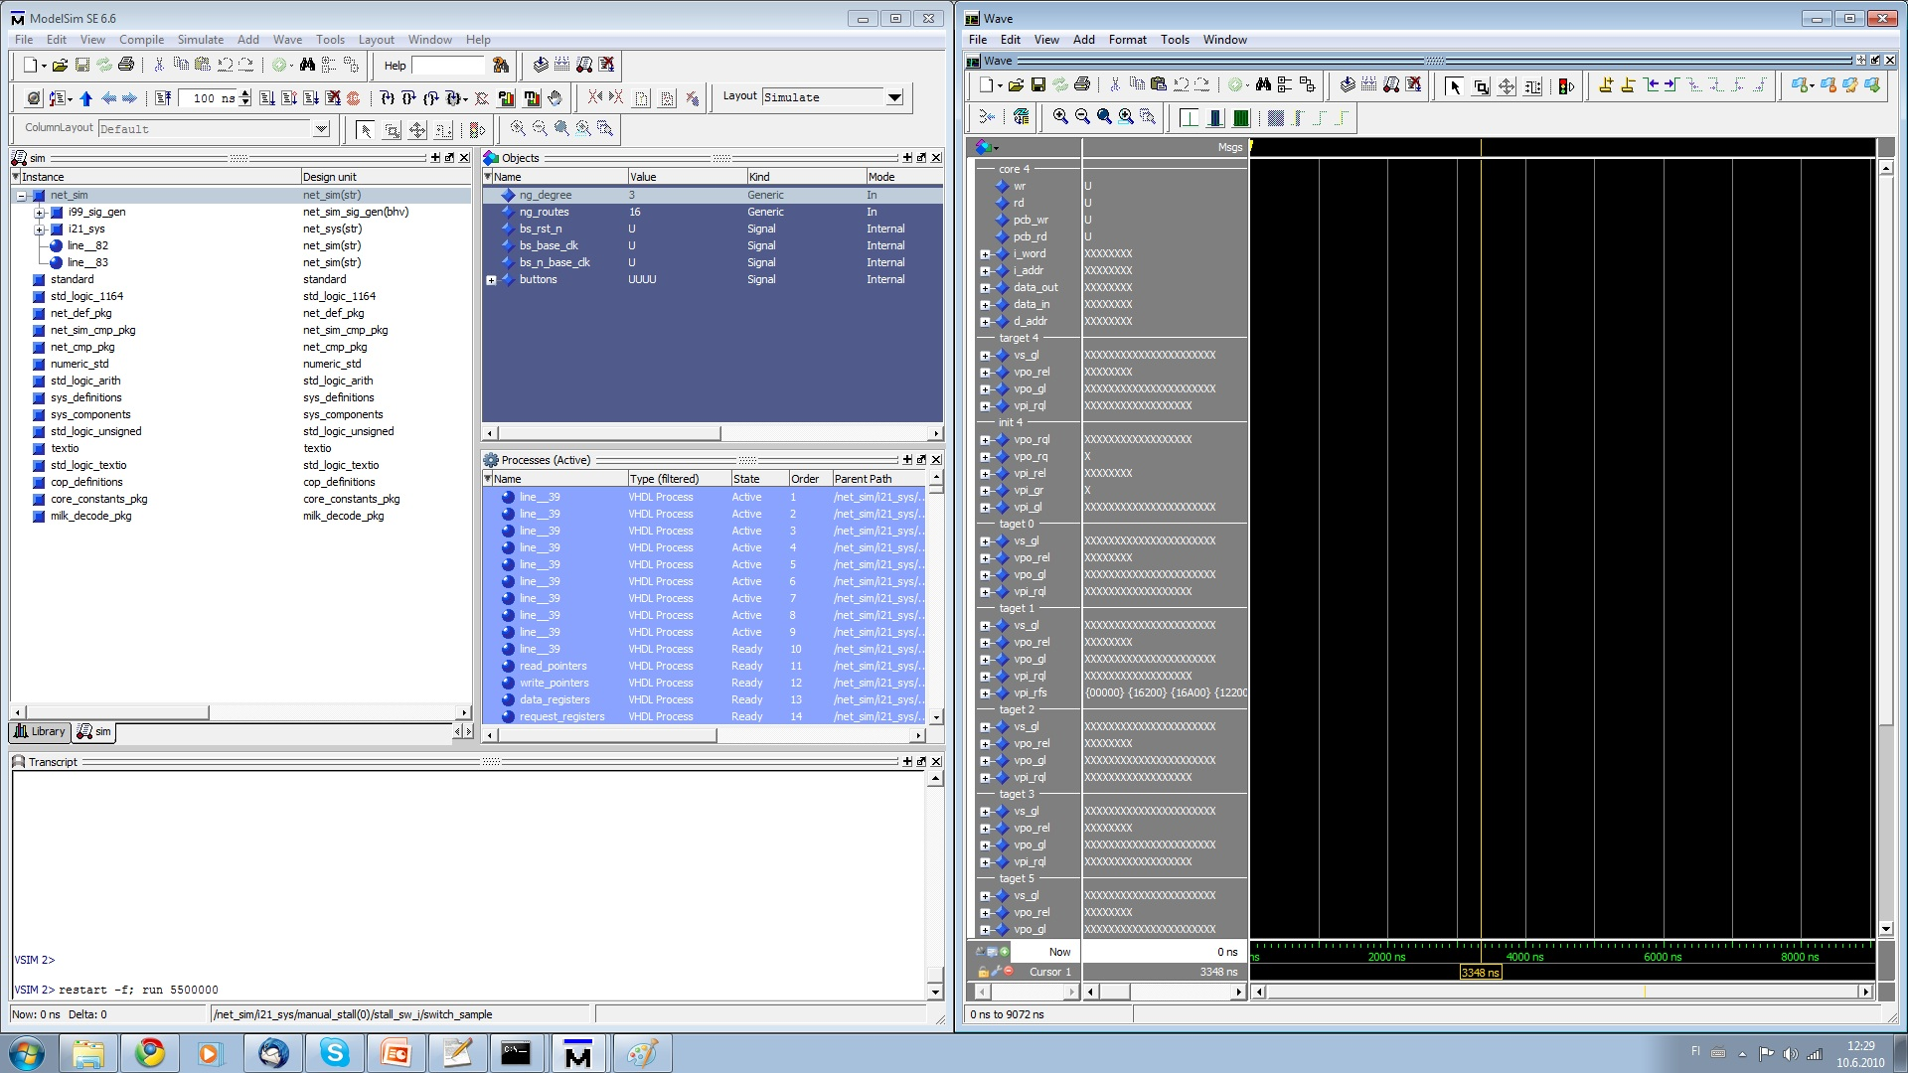
WAVEFORM
MODELSIM

Slide 15
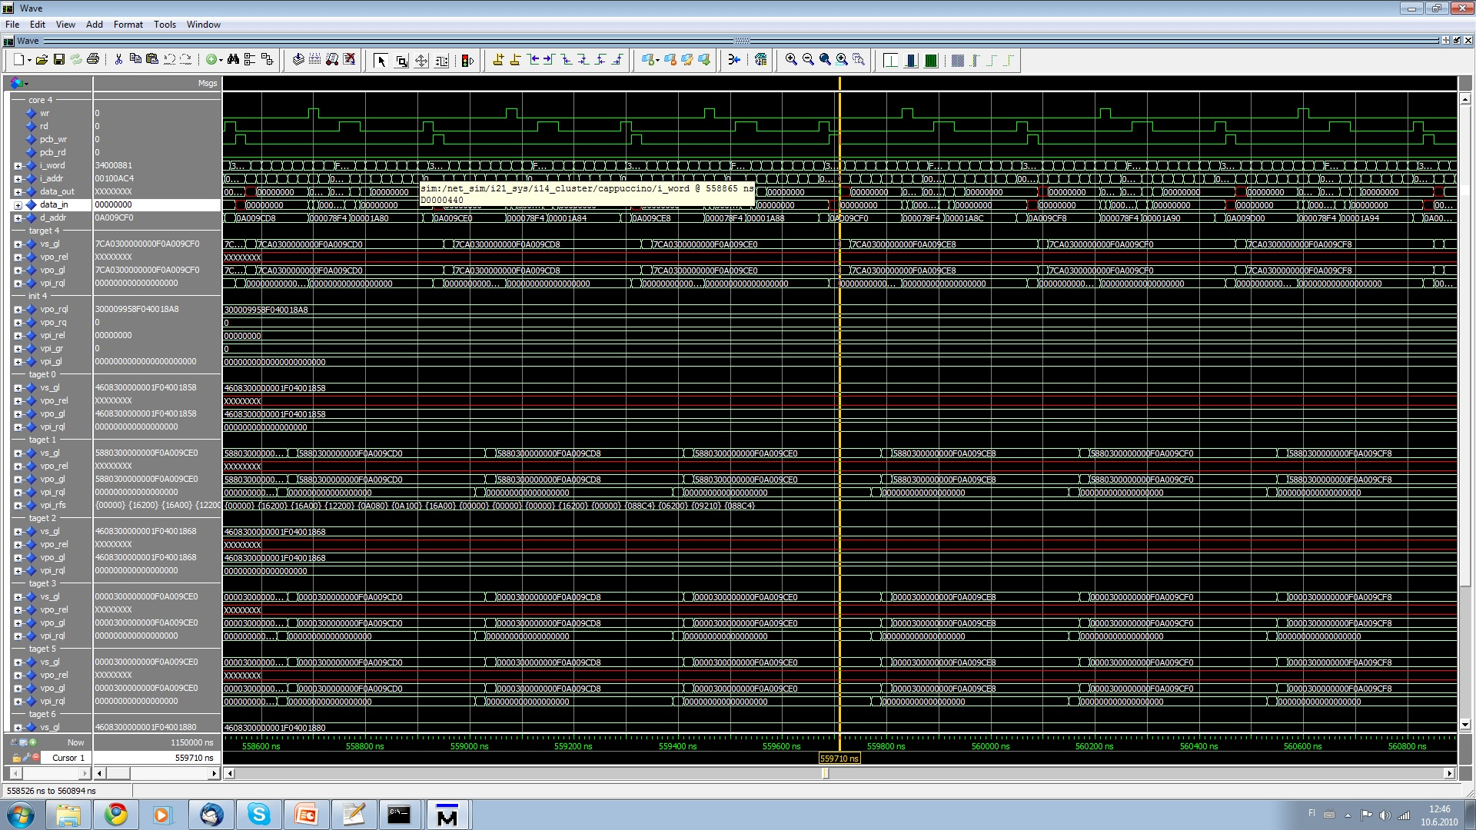
CORE 4 signals: Data_addrr Data read write....
NI 4 signals: packet data write....

Slide 16
Example
Matrix-vector multiplication

